Slide 1
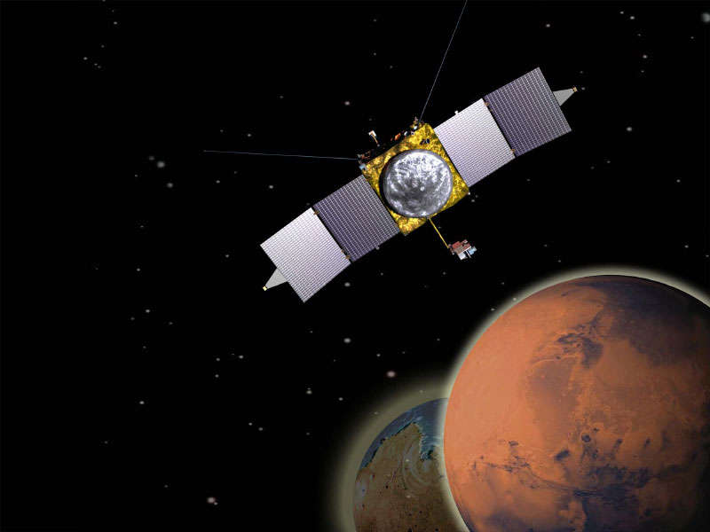
The MAVEN Mission:
Solving Mars’ Climate Mystery

Slide 2
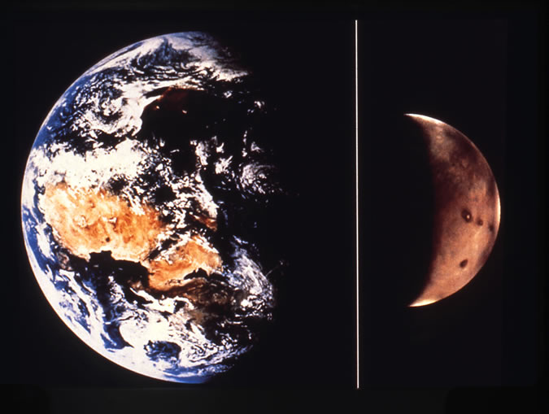
Earth
Mars
Notes:
Comparison of Earth and Mars, to connect Mars up with something that is more familiar. Mars is about 1/10 mass of Earth, ½ diameter of Earth. It’s atmosphere is just less than 1 % as thick as Earth’s, and is predominantly CO2. Mars is about 1.5x as far from the Sun as Earth is. Combination means that Mars is too cold and dry to allow liquid water to be stable on the surface.

Slide 3
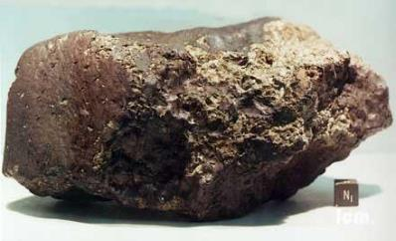
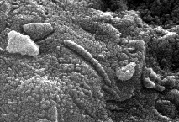
Overarching Question: Did Mars Ever Have Life?
Mars appears to meet or have met all of the environmental requirements for the occurrence of life:
Liquid water
Access to the biogenic elements (major ones include: carbon, hydrogen, oxygen, nitrogen, sulfur, and phosphorus)
Source of energy to drive metabolism
Did Mars ever have life?
How did any life interact with its planetary environment?
How has the habitability of Mars changed over time?

Slide 4
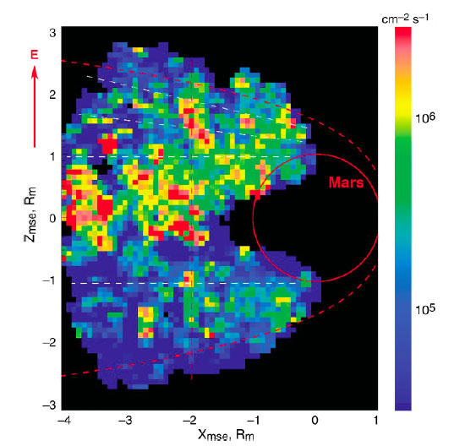
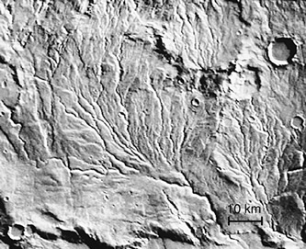
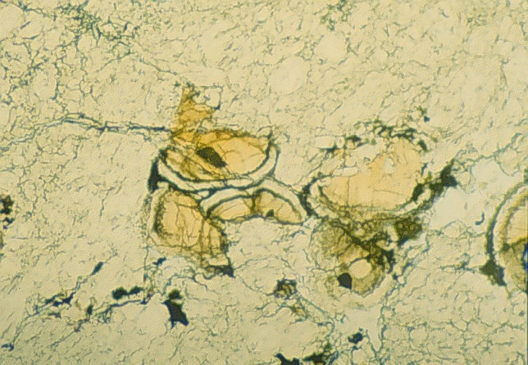
Evidence for Surface Water on Ancient Mars Where Did the Water Go? Where Did the CO₂ Go?
Abundant evidence for ancient water
Volatiles can be lost to space
Escaping ions detected from Mars Express
Volatiles can go into the crust
Carbonate deposits in a Martian meteorite
Notes:
There is abundant evidence for liquid water on ancient Mars. Upper left image shows “runoff channels” that look like river drainage systems. Also seen are geological evidence for ancient lakes filling impact craters and minerals that form only in presence of liquid water. Almost none of that occurs subsequent to about 3.5 or 3.7 billion years ago. Where did the water and CO2 go? Only two options: into crust or out to space. Bottom image shows grains inside of ALH84001 meteorite (from Mars, found on Earth), showing that carbonate minerals do exist and some of the CO2 has gone into the crust; not enough to account for thick CO2 atmosphere. Right image shows evidence for atmosphere being removed from Mars to space, from ESA Mars Express mission. MAVEN is going to quantify that loss and understand the processes responsible.

Slide 5
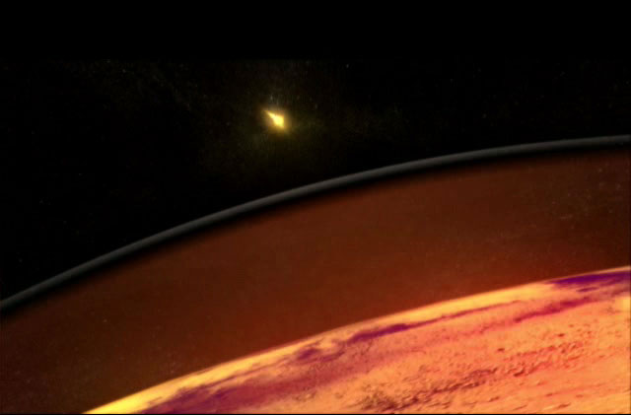
MAVEN Science Objectives
Evidence suggests that early Mars had flowing water on the surface and a thicker atmosphere.
The ancient Sun was more intense and likely drove significant escape of gas to space.
Determine the structure and composition of the Martian upper atmosphere today
Determine rates of loss of gas to space today
Measure properties and processes that will allow us to determine the integrated loss to space through time
MAVEN will answer questions about the history of Martian volatiles and atmosphere and help us to understand the nature of planetary habitability.
Notes:
To hold water on the surface (in addition to gravity), there must have been a thicker, more dense atmosphere on Mars. Because of its smaller diameter (~1/2 that of Earth’s), Mars cooled more quickly (relative to Earth), lost its global magnetic field and became susceptible to stripping off of its atmosphere by the solar wind. This process may have been responsible for much of the loss of water and carbon dioxide from Mars’ upper atmosphere. MAVEN will quantify these stripping processes and extrapolate back in time through modeling to create a better understanding of how they’ve contributed to Mars’ climate evolution.

Slide 6
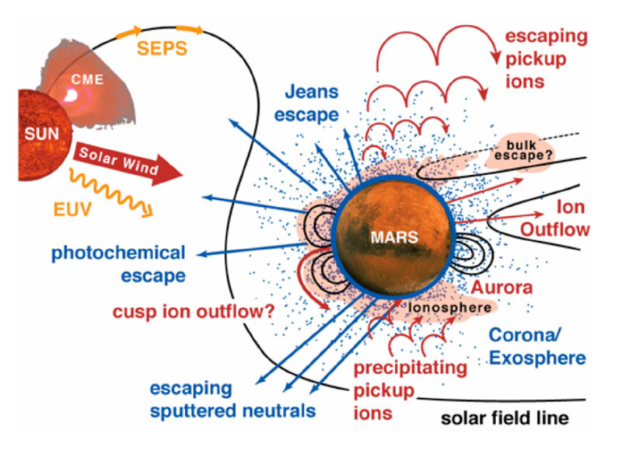
MAVEN Will Allow Us to Understand Escape of Atmospheric Gases to Space
MAVEN will determine the present state of the upper atmosphere and today’s rates of loss to space.
Measurements will allow determination of the net integrated loss to space through time.
Notes:
Graphic showing all of the different processes that could be responsible for loss, along with the energetic drivers from the Sun (solar wind, solar energetic particle events, EUV photons). Point of this is that (i) we’ve thought through the possible processes (although we don’t know if they actually operate at Mars), (ii) we selected instruments to be able to understand these, and (iii) we anticipate that we have a robust enough payload that it can decipher whatever we see.

Slide 7
The Solar Wind is Able to Strip Off Gas from the Top of the Atmosphere
Notes:
This one shows one quantitative numerical model of one process, but it shows it very graphically. It’s removal of the upper atmosphere by the solar wind. The change halfway through shows what happens if the solar wind suddenly doubles in intensity (Too much going on and I haven’t been able to specifically refer to that, but wanted to let you know).

Slide 8
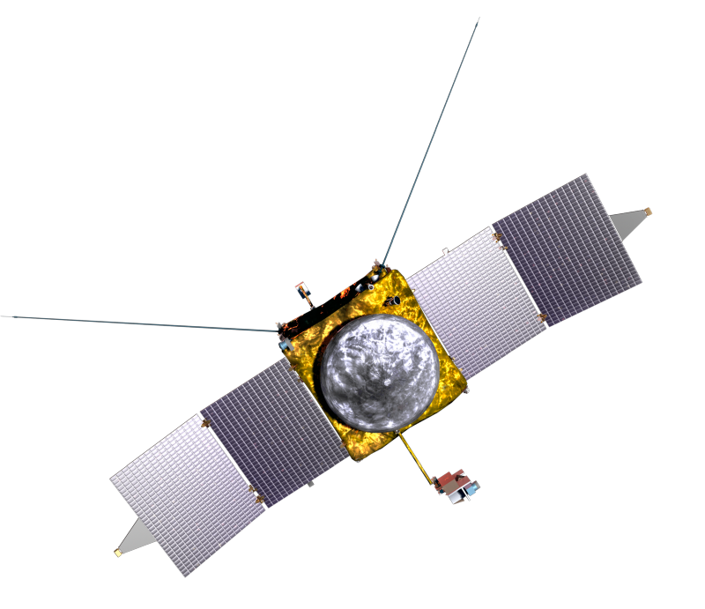
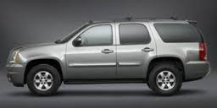
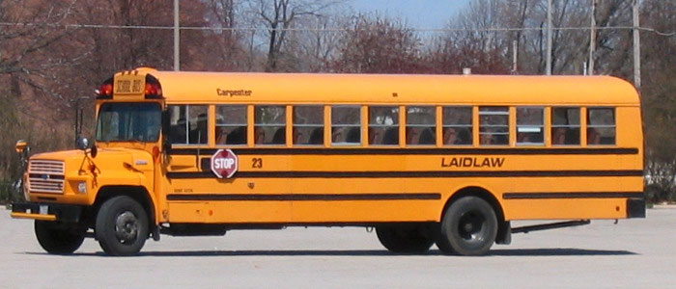
The MAVEN Spacecraft
Same weight fully loaded as a GMC Yukon – 2550 kg.
Same length as a school bus – wingtip-to-wingtip length of 37ft.

Slide 9
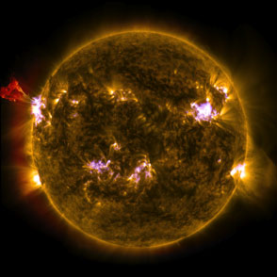
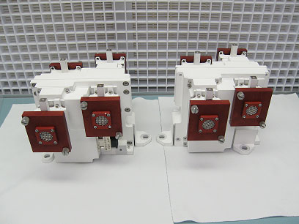
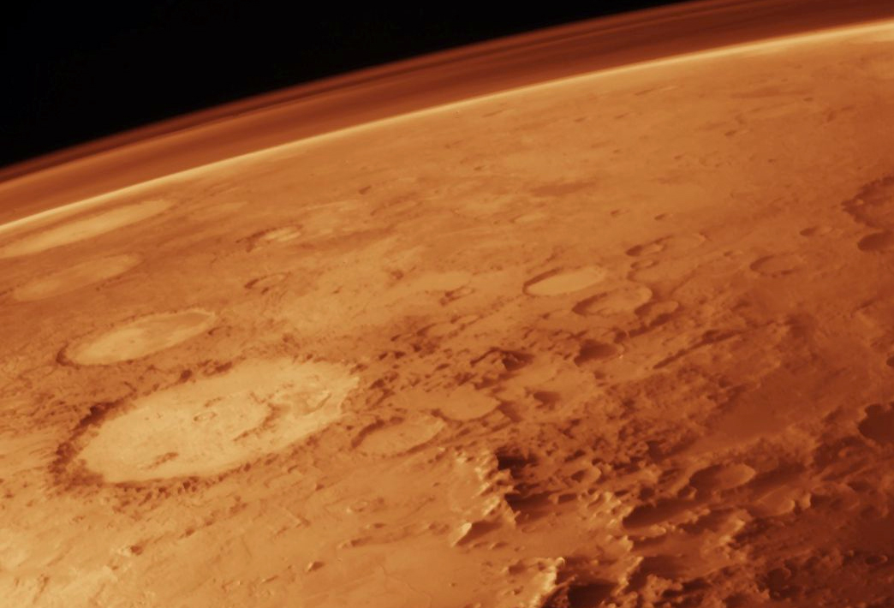
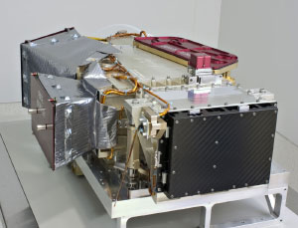
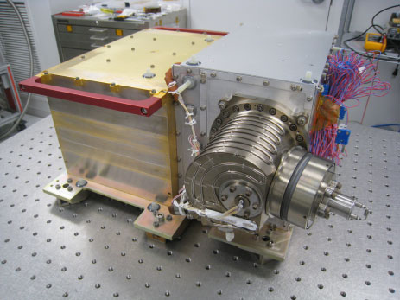
The MAVEN Science Instruments:
Sun, Solar Wind, Solar Storms
SEP
SWEA
Neutrals and Ions Plus Evolution
EUV
SWIA
Ion-Related Properties and Processes
IUVS
NGIMS
STATIC
MAG
LPW
Notes:
MAVEN instruments and spacecraft. The “solar” instruments do other things as well, but I’ve lumped them here for simplicity on the chart and so that each instrument is shown only once.

Slide 10
The MAVEN Spacecraft
3-axis attitude control (wheel based)
Mono-propellant propulsion system
Single-fault tolerant during all critical events
Launch (Wet) Mass: 2550 kg max
Spacecraft Dry Mass: 903 kg max
Power: 1135 W at Mars Aphelion
LPW (2)
SWEA
Electra (behind)
SWIA
SEP
“Gull-Wing” Solar Arrays
Fixed HGA
MAG (2)
SEP
Articulated Payload Platform (IUVS/STATIC/NGIMS)

Slide 11
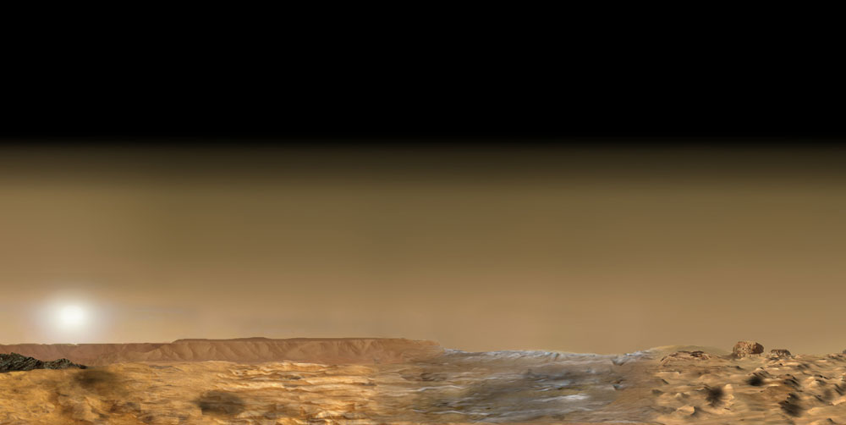
NASA’s Mars Exploration Program
Launch Year
Operational / Recent
2009
2011
2013
2016
2018 & Beyond
Odyssey
MRO
MAVEN
Mars Express
Coop
MSL - 2020
MER
Phoenix
InSight
Mars Science Lab
Notes:
MAVEN is the first mission devoted to understanding Mars’ upper atmosphere and using this information to help solve Mars’ climate mystery. It is one mission in a series devoted to exploring Mars and will contribute to the search for habitable environments on our planetary neighbor.

